Slide 1
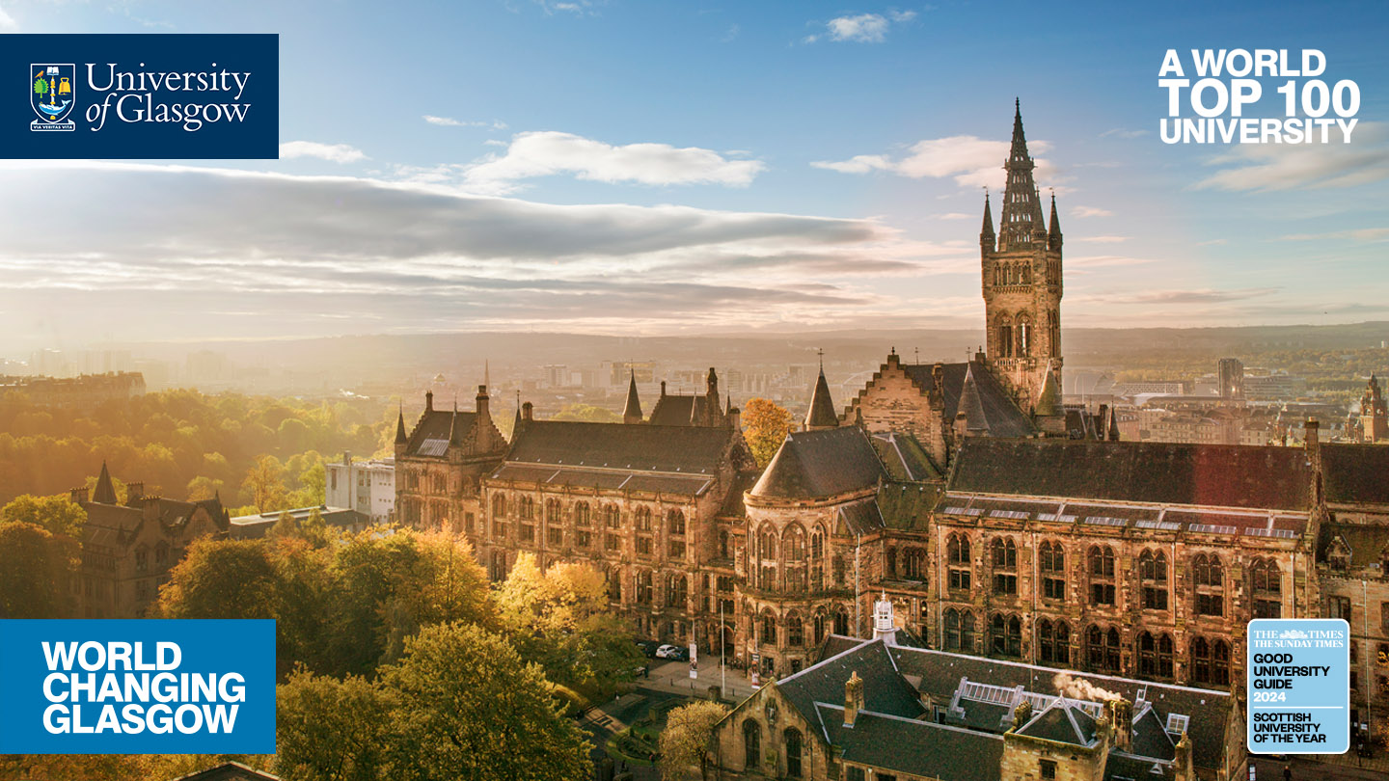
Digital Twins, Version Control, & Generative AI Education
Dr Vinny Davies, Senior Lecturer in Statistics
School of Mathematics & Statistics, University of Glasgow

Slide 2
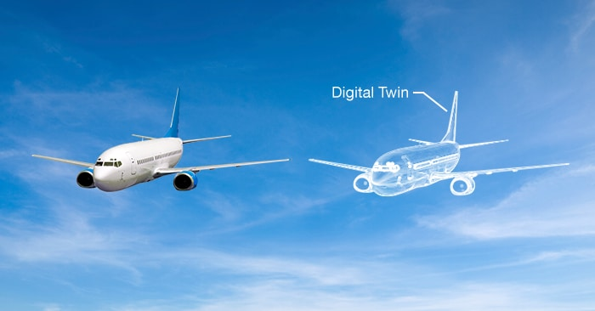
What is a Digital Twin?
A digital twin is essentially a digital replica of some real-life process
Generally, the digital twin will be a computerised version of the real-life process that allows us to simulate the process and understand what would happen in different situations

Slide 3


So, what actually is a Digital Twin?
Digital Twin
Real System

Slide 4
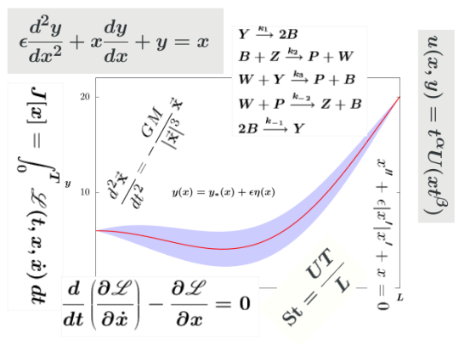
So, what actually is a Digital Twin?
Physical Model
Digital Twin
Real System

Slide 5
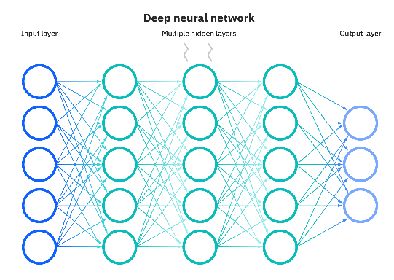
So, what actually is a Digital Twin?
ML / AI Model
Digital Twin
Real System

Slide 6

So, what actually is a Digital Twin?
Digital Twin
Real System
Code

Slide 7
So, what actually is a Digital Twin?
Physical Model
ML / AI Model
Digital Twin
Real System
Code

Slide 8
So, what actually is a Digital Twin?
Digital Twin
Physical Model
ML / AI Model
Digital Twin
Real System
Code

Slide 9
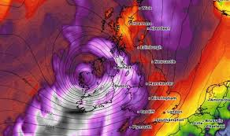
So, what actually is a Digital Twin?
Weather Data
Digital Twin
Physical Model
ML / AI Model
Digital Twin
Code

Slide 10
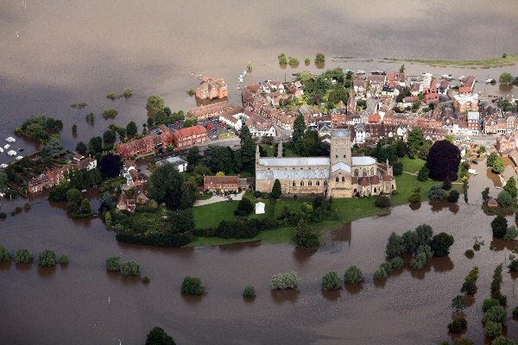
So, what actually is a Digital Twin?
Weather Data
Digital Twin
Physical Model
Flooding Data
ML / AI Model
Digital Twin
Code

Slide 11
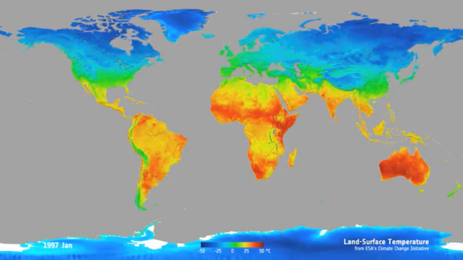
So, what actually is a Digital Twin?
Weather Data
Digital Twin
Physical Model
Flooding Data
ML / AI Model
Temperature Data
Digital Twin
Code

Slide 12
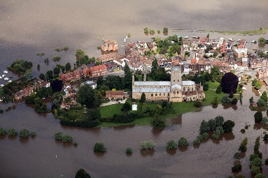

So, what actually is a Digital Twin?
Data
Digital Twin
Physical Model
ML / AI Model
Digital Twin
Code

Slide 13
So, what actually is a Digital Twin?
Training models and parameters
We can use the combination of our digital twin and available data to train the models and parameters of the digital twin
Data
Digital Twin
Physical Model
ML / AI Model
Digital Twin
Code

Slide 14
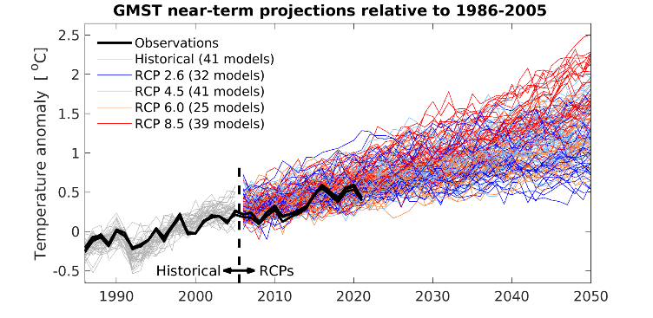
So, what actually is a Digital Twin?
Training models and parameters
We can use the combination of our digital twin and available data to train the models and parameters of the digital twin
Data
Digital Twin
Physical Model
ML / AI Model
Scenario Planning
Digital Twin
Code

Slide 15
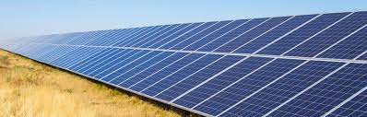
So, what actually is a Digital Twin?
Training models and parameters
We can use the combination of our digital twin and available data to train the models and parameters of the digital twin
Data
Digital Twin
Physical Model
ML / AI Model
Scenario Planning
Digital Twin
Tool / Intervention
Code

Slide 16
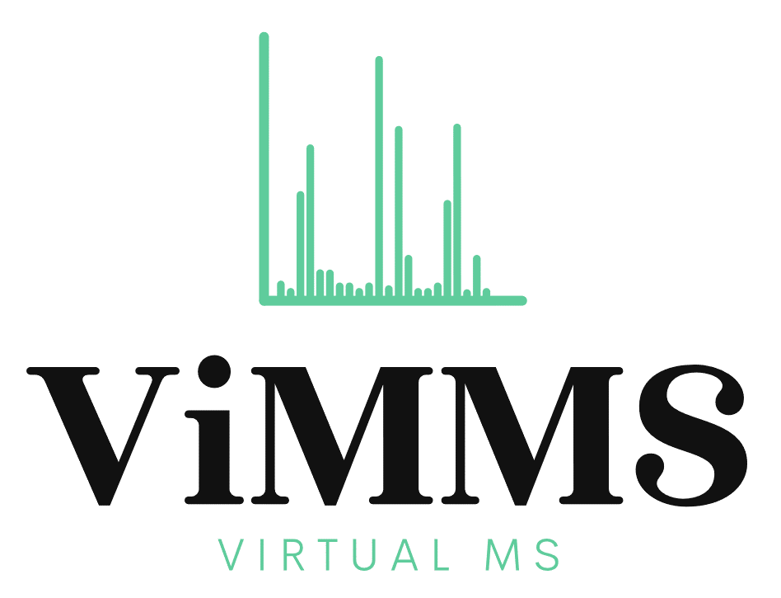
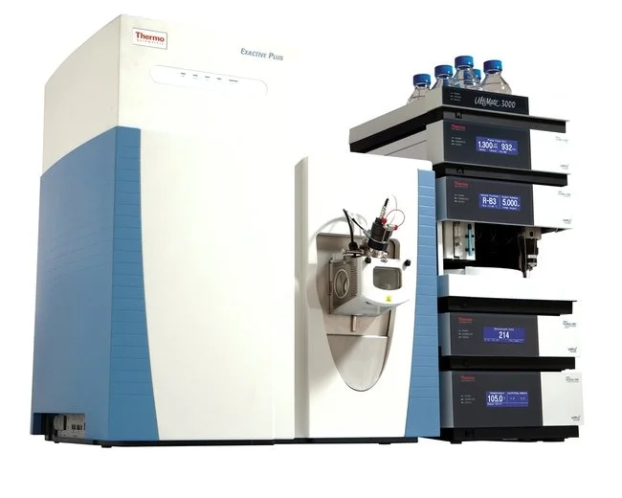
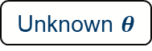

Digital Twin Projects
Project Areas – Metabolomics, Biodiversity, Cardiac Mechanics, Engineering, Environment
Project Collaborators – Across CoSE and MVLS. Several industrial partners.
Simulated Results
Unknown $θ$
Simulated Results
Optimised $θ$
Real Results
Prototype
Controller
Controller
Controller

Slide 17

Version Control
Spending some time as a PDRA in Computing Science made me very frustrated about the lack of code sharing in Mathematics and Statistics
We have designed a course around version control using Git/GitHub
Aimed at a very non-technical audience
Cohorts – UGs, PGTs, PGRs, Staff
Course teaches in both command-line and via GitHub Desktop

Slide 18
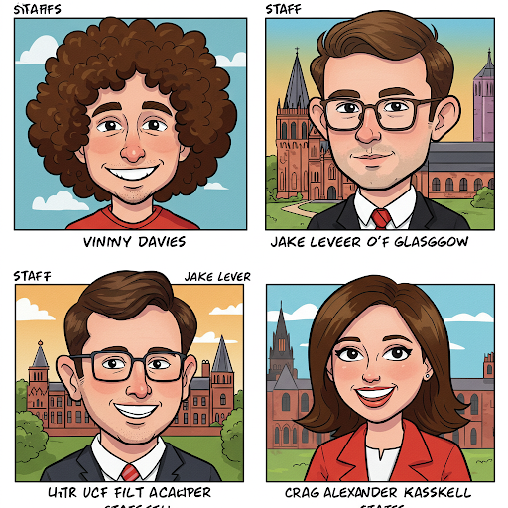


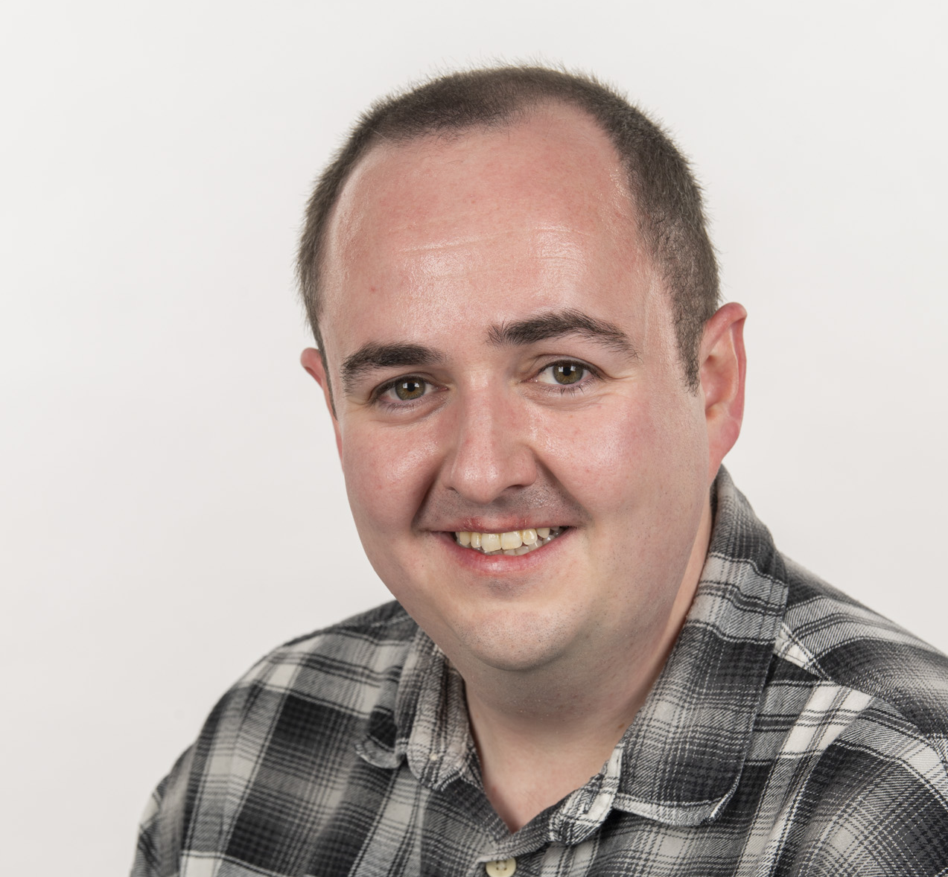
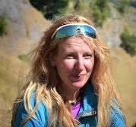
Generative AI for Data Science
Project related to using Generative AI tools in Data Science
E.g. to help code more efficiently
Does not aim to teach Generative AI, instead encourages people to self-evaluate their own usage
Key themes
Education
Development
Reporting
Safety
Vinny Davies (M&S)
Jake Lever (CS)
Craig Alexandar (M&S)
Jenn Gaskell (M&S)

Slide 19




If you are interested in collaborating, then you can contact me at Vinny.Davies@Glasgow.ac.uk Slides available at https://github.com/vinnydavies/presentations/2025
#UofGWorldChangers
@UofGlasgow

